Slide 1
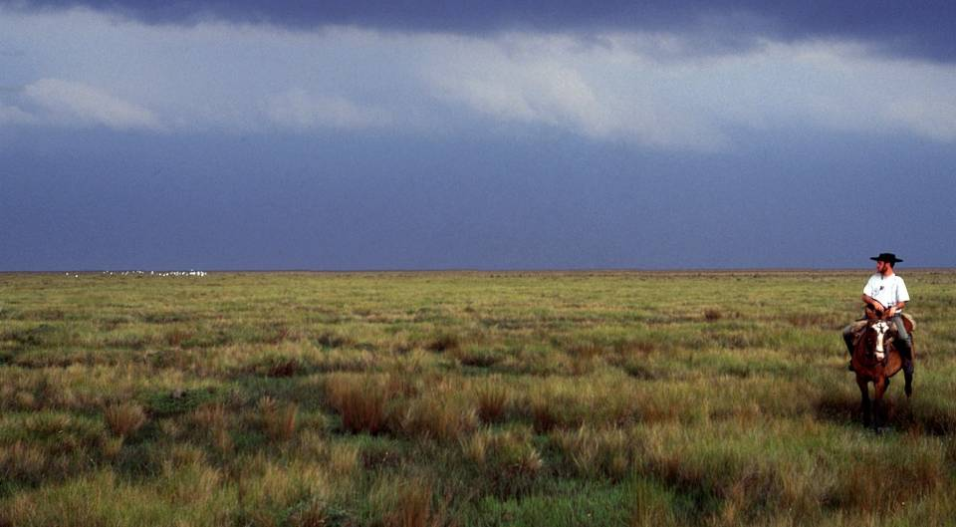
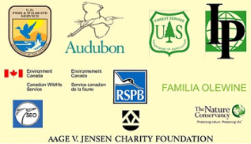
Southern Cone Grasslands Alliance
Conservation of migratory birds in the Southern Cone Grasslands

Slide 2
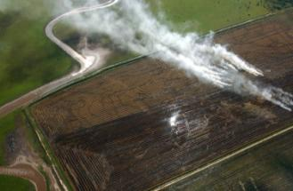
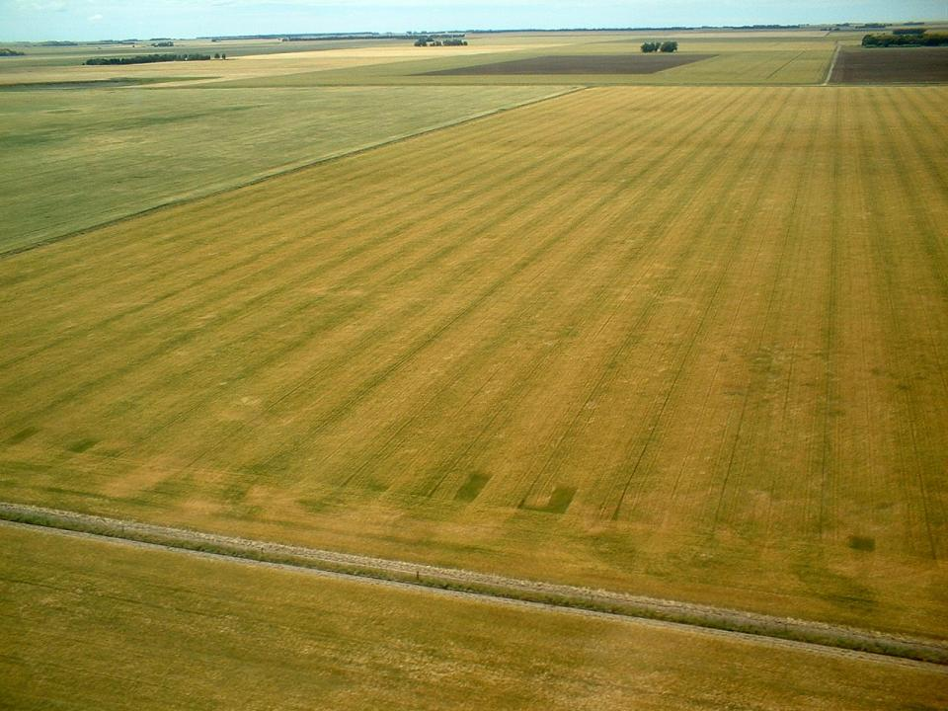
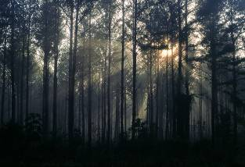
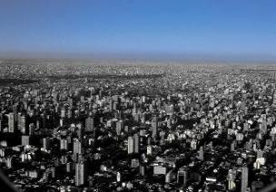
The Southern Cone (or Pampas) Grasslands are an important wintering and breeding area for grassland-dependent migratory birds. Yet they are highly threatened by conversion to agriculture (especially row crops), forestry plantations and urbanization.

Slide 3
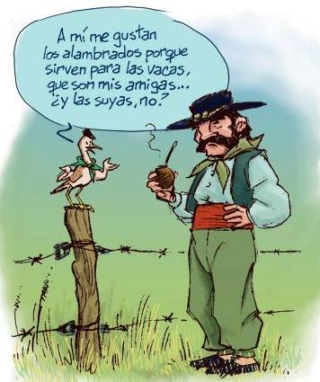
With nearly all of the Southern Cone Grasslands area in private hands, conservation depends on working with landowners, many of whom maintain traditional ranching lifestyles.

Slide 4
Fortunately, traditional extensive grazing regimes are not only compatible with grassland bird conservation, but are often necessary to create the mosaic of grassland habitats that birds and other biodiversity require.

Slide 5
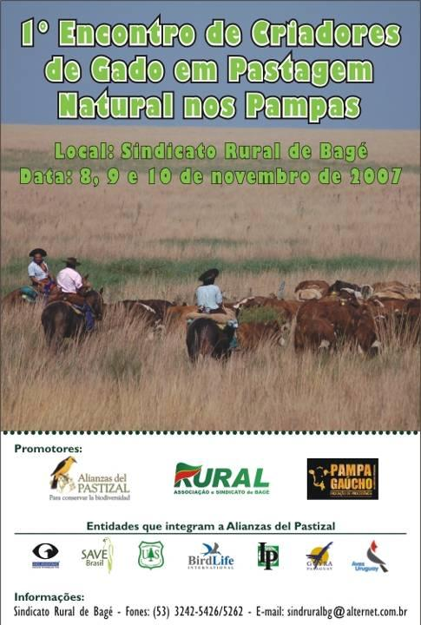
Since 2005, the BirdLife national partner organizations have been working with producers and government agencies to develop incentive schemes for the application of best management practices on natural grasslands that benefit migratory birds and other biodiversity, while helping to build the economic (and cultural) sustainability of natural grasslands ranching.

Slide 6
Key steps to building ecological, economical and social sustainability of ranching have included:
Documentation of existing best management practices - bmps (in manuals).
Exchanges of experiences between ranchers (including annual natural grasslands ranchers meeting).
Trialing of bmps at pilot sites in each country.
Monitoring and research at each pilot site.
Feasibility/market studies for “natural grasslands beef”.

Slide 7
Key steps continued…
6. Development of a natural grasslands beef certification protocol (standard).
Pilot certification scheme and “tasting events” of natural grasslands beef.
Development of an Alliance membership scheme (with benefits for producers).
Development of a Grasslands Conservation Index to support other incentive schemes.
Outreach and dissemination.
Link to CMS Grassland Migrants MoU (Alliance implements many priorities in the MoU Action Plan)

Slide 8
Progress to date
137 “rural establishment” Alliance members applying best management practices on 142,000 ha, another 204 properties in process of joining.
84,000 ha of natural grasslands certified to date, another 112,000 ha in process of certification.
10,000 kg/month certified beef on sale in Argentina, and first export to Europe.
Novel index being used to support market, fiscal and credit incentives for grasslands conservation.

Slide 9
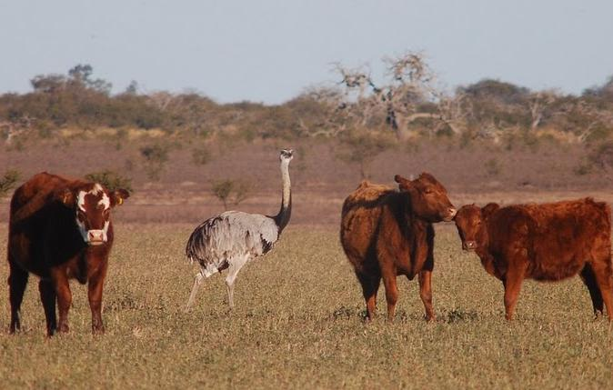
Lessons Learned
Engaging with ranchers from the very beginning
Promoting ranchers as the “heroes” of grasslands conservation
Dedicated team of coordinators (regional, national)
Working with authorities to capitalize on existing and to develop new policy and legal frameworks for incentives

Slide 10
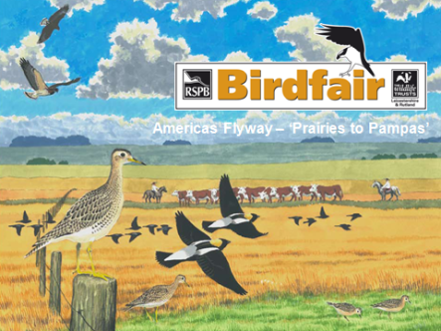
Challenge: Building broad support (including consumer demand) for sustainably managed grasslands.
Opportunities: Development of new market, fiscal, and credit-based incentives for grassland conservation.
Growing interest in a hemispheric approach (for instance the 2013 British Birdwatching Fair raised funds to support the conservation of migratory grassland birds from the “Prairies to Pampas”).

Slide 11
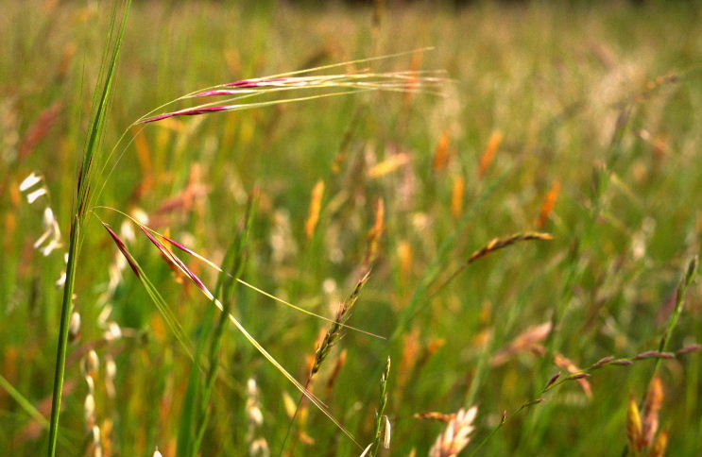
Additional information: http://www.alianzadelpastizal.org/ https://www.youtube.com/user/AlianzadelPastizal Regional Coordinator: Nicolas Marchand nicolas.marchand@birdlife.org

